Slide 1
Check projector: picture contrast is bumped up to show better on computer, but some projectors make this too dark.

Slide 2
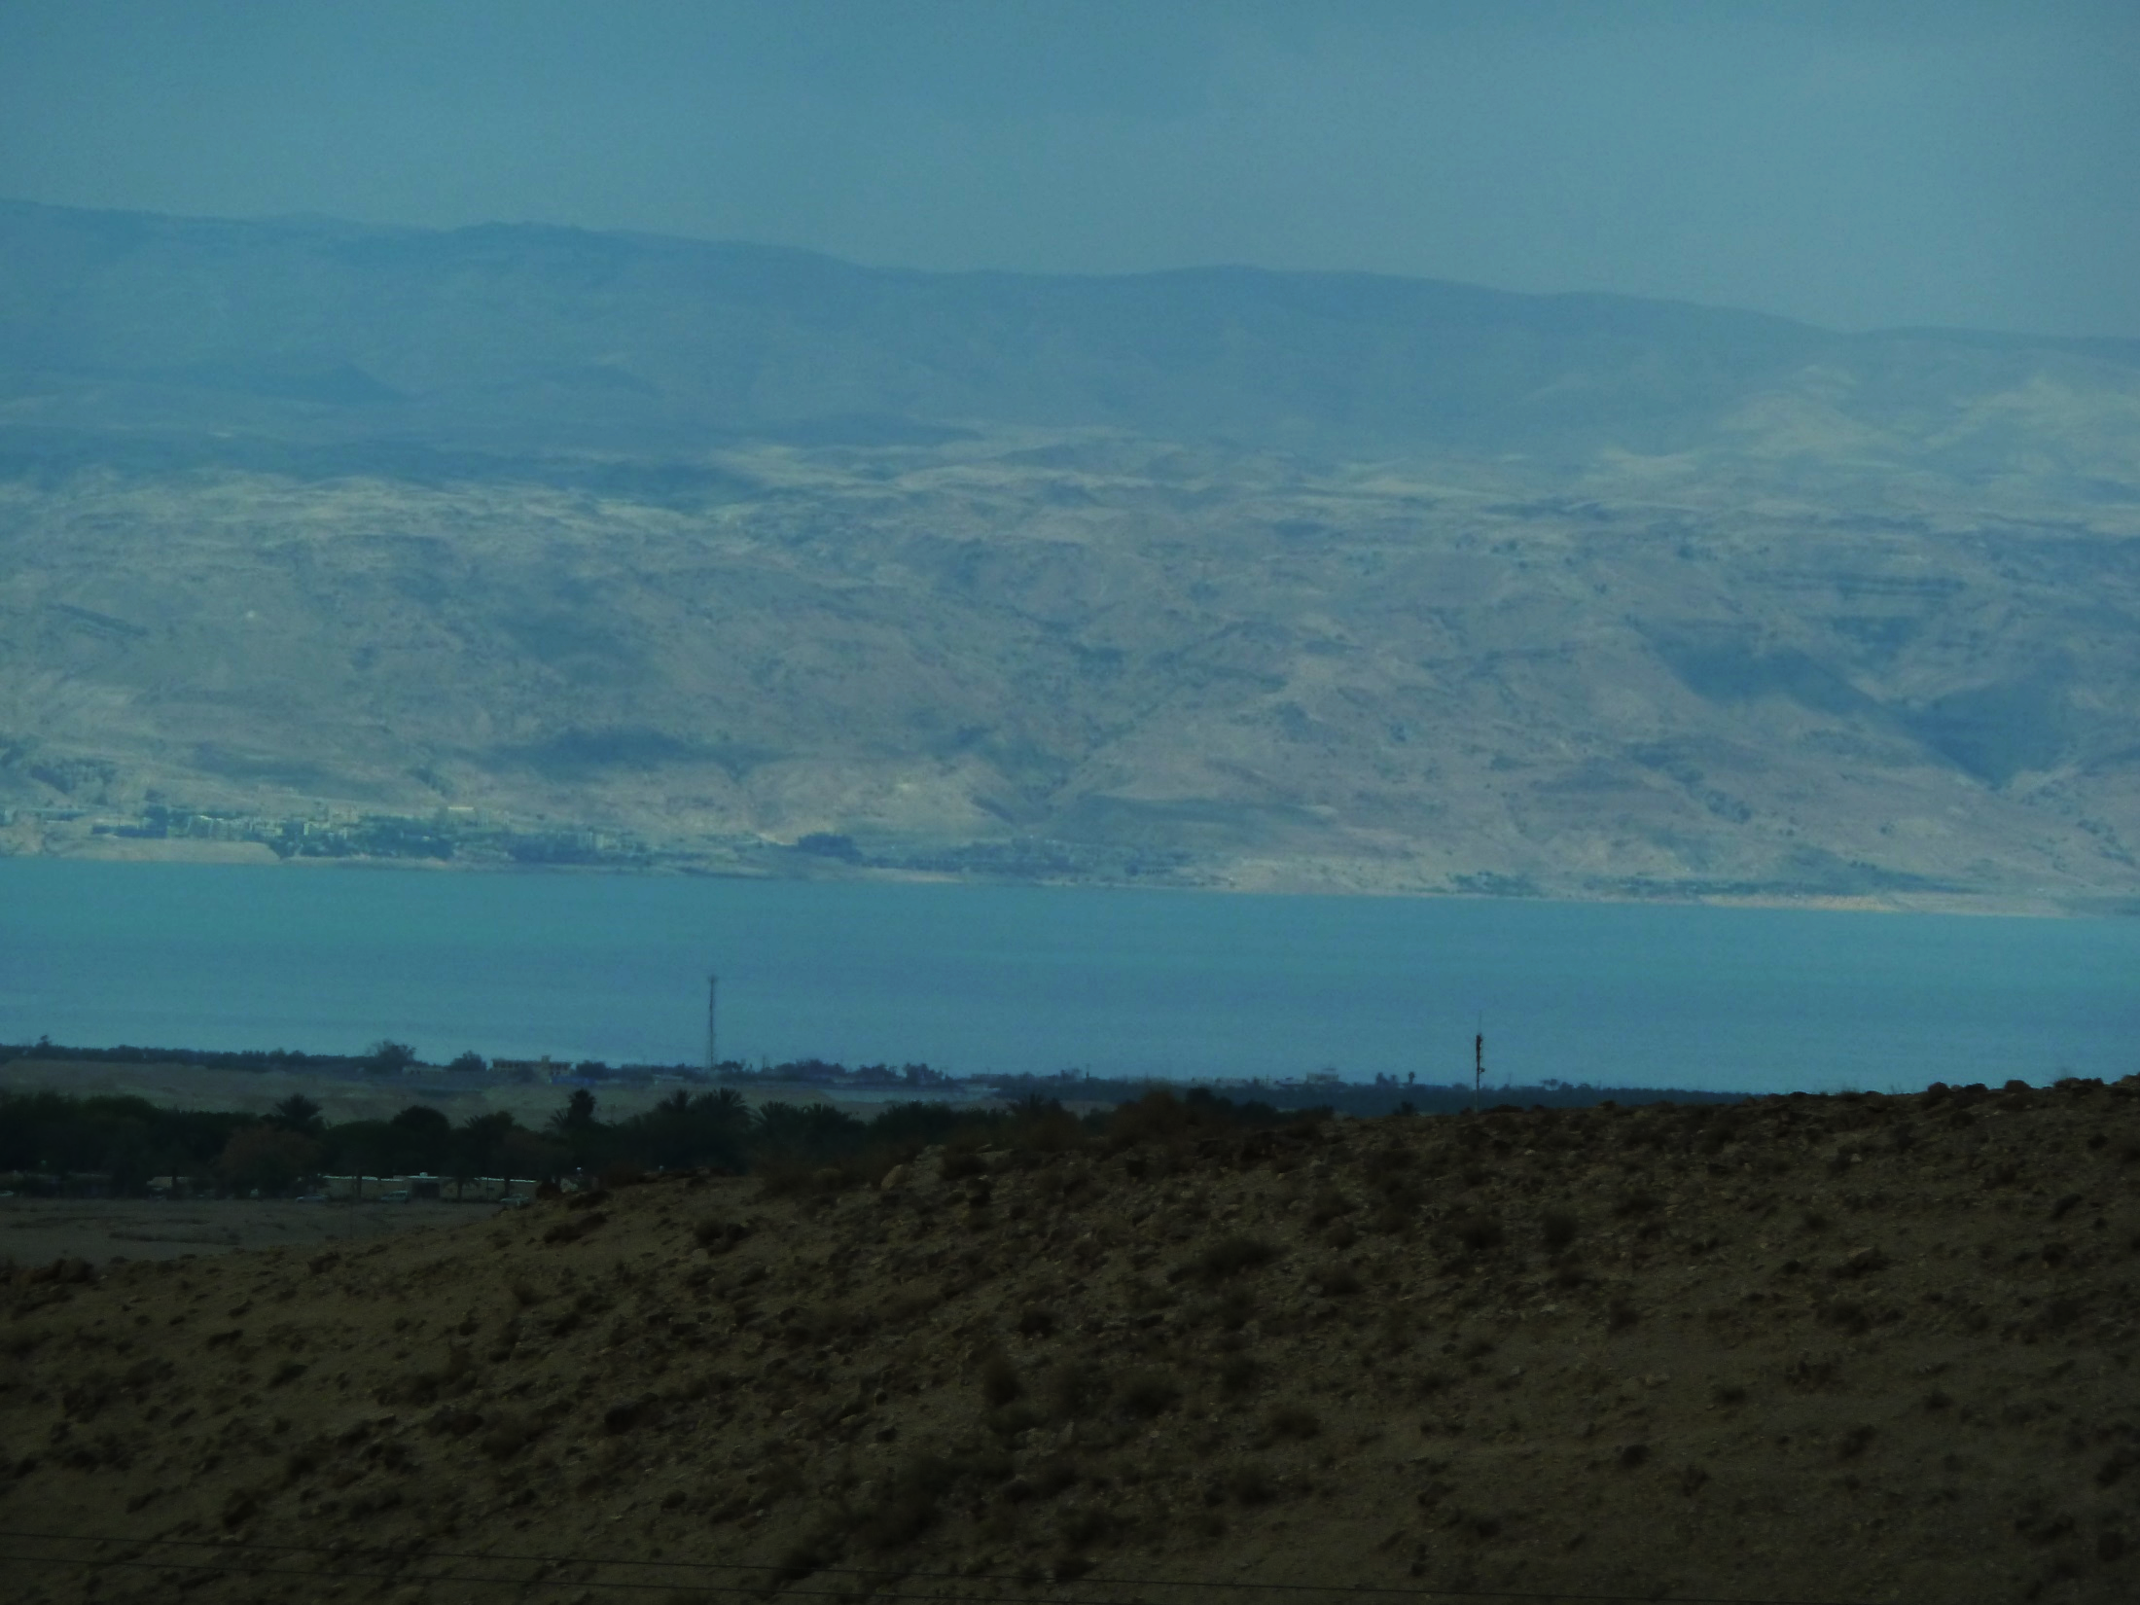
Ruth 4.13: So Boaz took Ruth, and she became his wife, and he went in to her. And the LORD enabled her to conceive, and she gave birth to a son.

Slide 3
Ruth 4.22: …and to Obed was born Jesse, and to Jesse, David.

Slide 4
Characters: Ruth and Naomi
Tensions: Lack of Food and Lack of Children
Narrative: Limited space and creative choices

Slide 5
Deuteronomy 28.1-2: Now it shall be, if you diligently obey the LORD your God, being careful to do all His commandments which I command you today, the LORD your God will set you high above all the nations of the earth. All these blessings will come upon you and overtake you if you obey the LORD your God…

Slide 6
Deuteronomy 28.11-12: The LORD will make you abound in prosperity, in the offspring of your body and in the offspring of your beast and in the produce of your ground, in the land which the LORD swore to your fathers to give you. The LORD will open for you His good storehouse, the heavens, to give rain to your land in its season and to bless all the work of your hand…”

Slide 7
Ruth 1.1a: Now it came about in the days when the judges governed, that there was a famine in the land.

Slide 8
Ruth 1.1a: Now it came about in the days when the judges governed, that there was a famine in the land.
After exodus from Egypt and entrance into promised land.
Jews had Mosaic & Abrahamic Covenants.
Cycle of disobedience, discipline by God, repentance, blessing by God.

Slide 9
Ruth 1.1a: Now it came about in the days when the judges governed, that there was a famine in the land.
Tension: lack of food
Cause: the people must have been disobedient for God to stop fulfilling the covenant blessings.

Slide 10
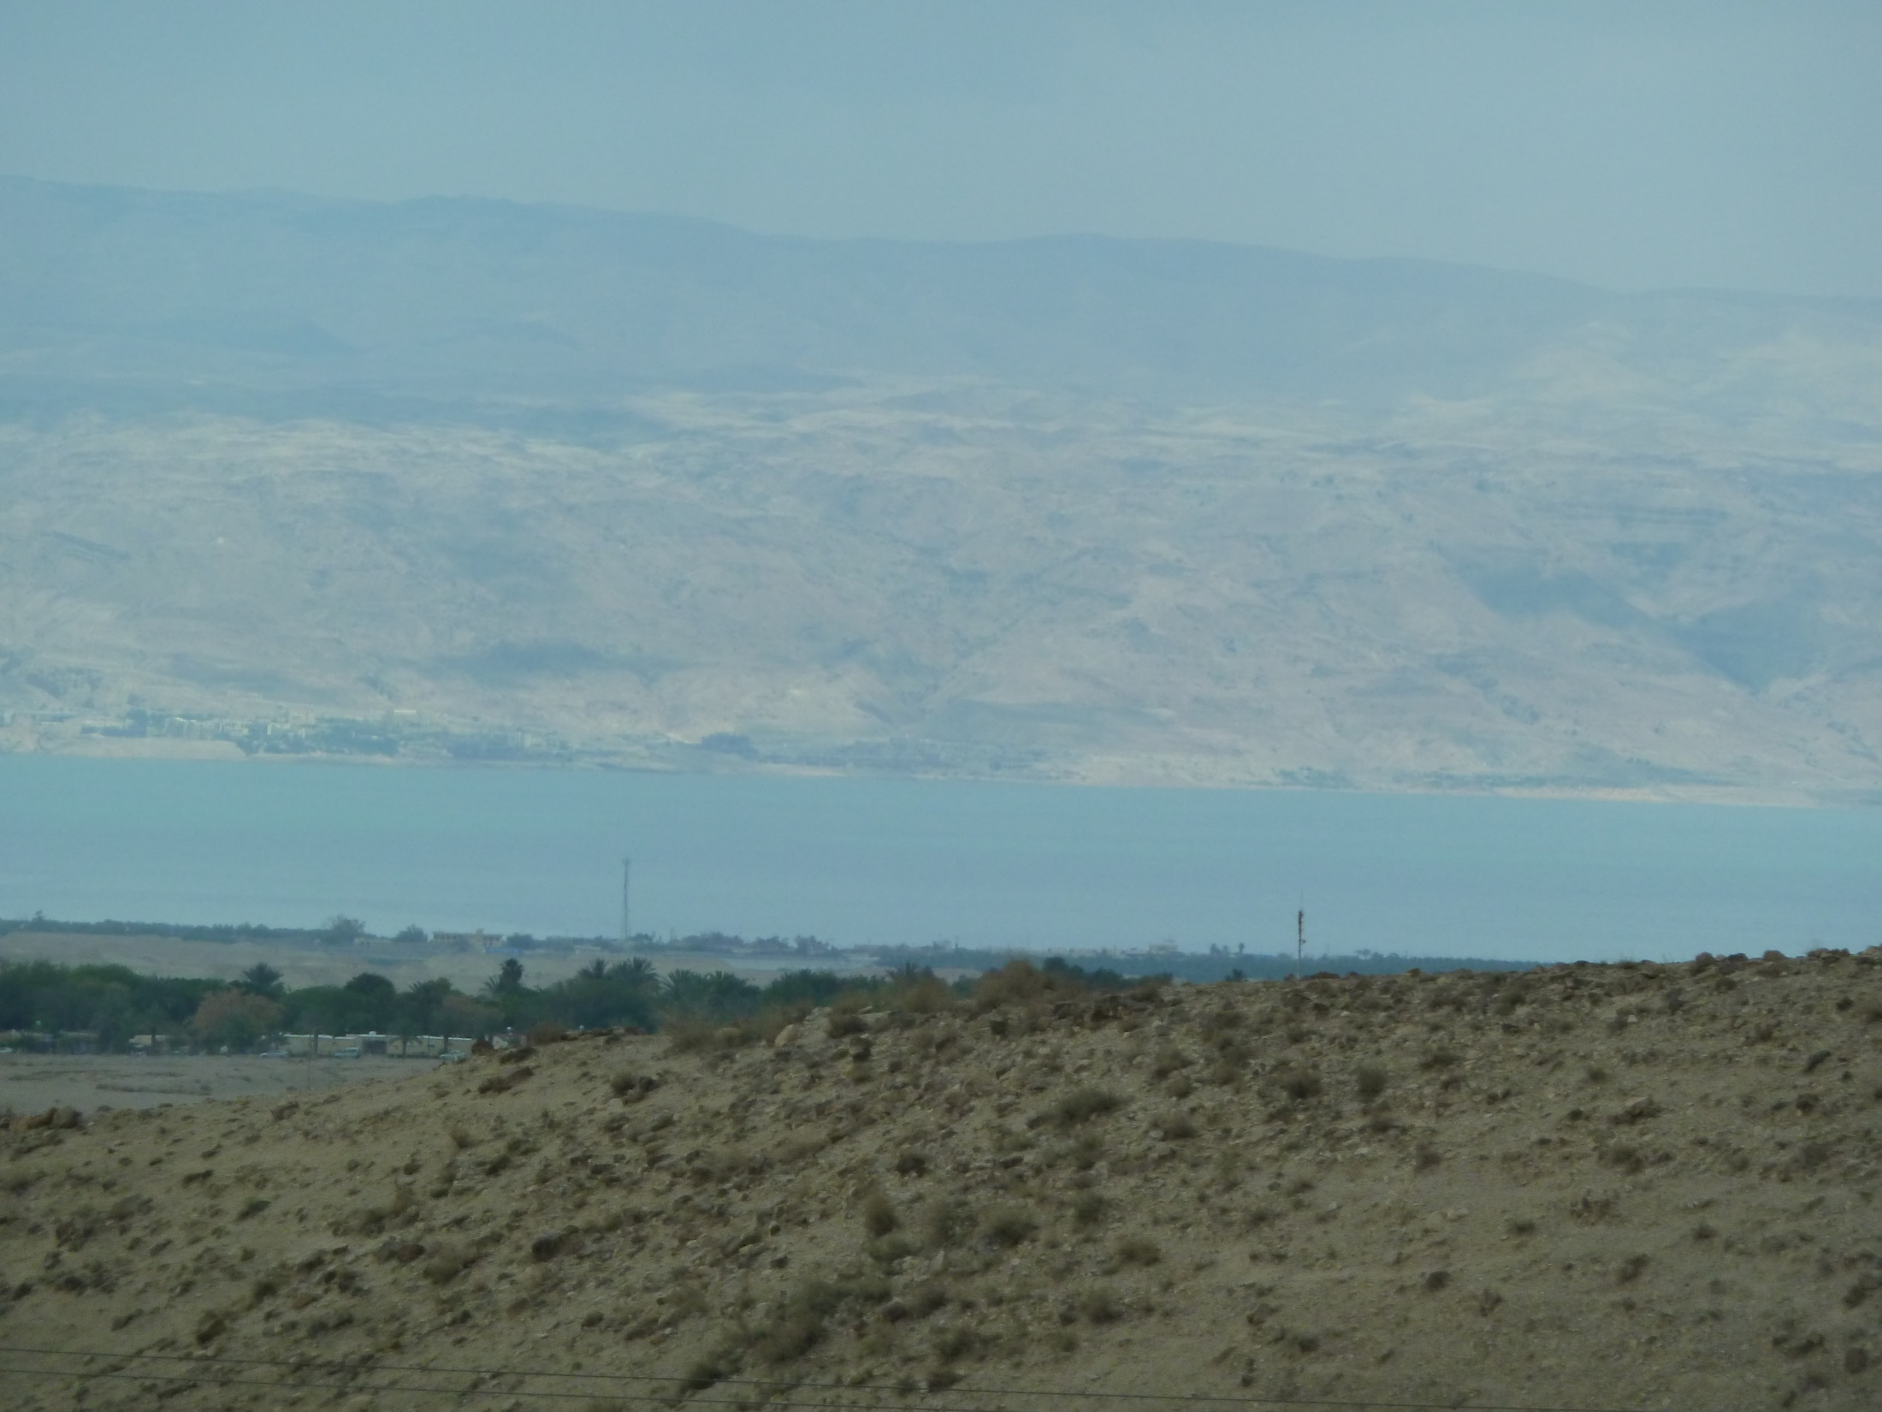
Leviticus 26:14-17a: But if you do not obey Me and do not carry out all these commandments, if, instead, you reject My statutes, and if your soul abhors My ordinances so as not to carry out all My commandments, and so break My covenant, I, in turn, will do this to you: I will appoint over you a sudden terror, consumption and fever that will waste away the eyes and cause the soul to pine away; also, you will sow your seed uselessly, for your enemies will eat it up. I will set My face against you so that you will be struck down before your enemies;

Slide 11
Leviticus 26:17b-20: and those who hate you will rule over you, and you will flee when no one is pursuing you. If also after these things you do not obey Me, then I will punish you seven times more for your sins. I will also break down your pride of power; I will also make your sky like iron and your earth like bronze. Your strength will be spent uselessly, for your land will not yield its produce and the trees of the land will not yield their fruit.

Slide 12
Deuteronomy 30.1-2: So it shall be when all of these things have come upon you, the blessing and the curse which I have set before you, and you call them to mind in all nations where the LORD your God has banished you, and you return to the LORD your God and obey Him with all your heart and soul according to all that I command you today, you and your sons,

Slide 13
Deuteronomy 30.3-5: then the LORD your God will restore you from captivity, and have compassion on you, and will gather you again from all the peoples where the LORD your God has scattered you. If your outcasts are at the ends of the earth, from there the LORD your God will gather you, and from there He will bring you back. The LORD your God will bring you into the land which your fathers possessed, and you shall possess it; and He will prosper you and multiply you more than your fathers.

Slide 14
Ruth 1.1b: And a certain man of Bethlehem in Judah went to sojourn in the land of Moab with his wife and his two sons.
Moab
Dead Sea
Judah

Slide 15
Ruth 1.2: The name of the man was Elimelech, and the name of his wife, Naomi; and the names of his two sons were Mahlon and Chilion, Ephrathites of Bethlehem in Judah. Now they entered the land of Moab and remained there.
Moab
Dead Sea
Judah

Slide 16
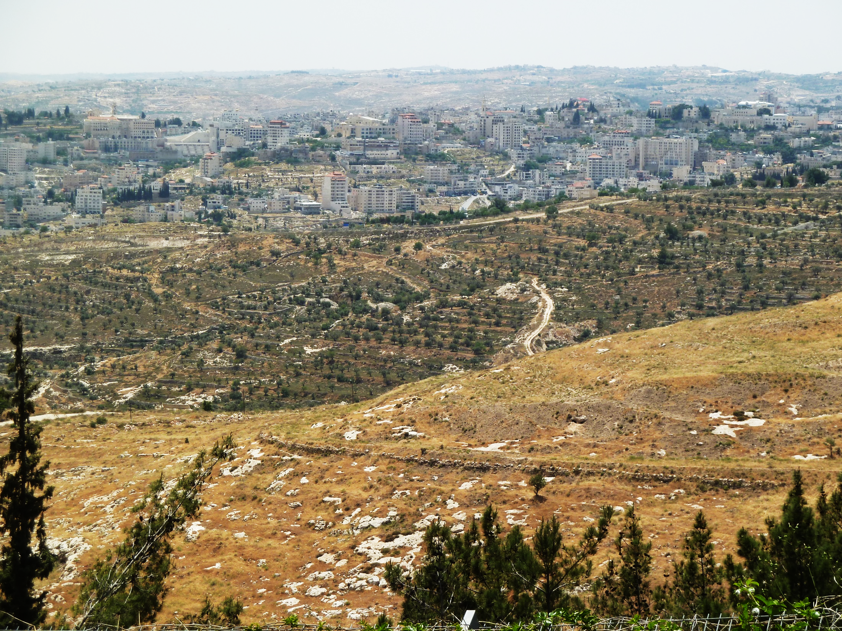
Bethlehem

Slide 17
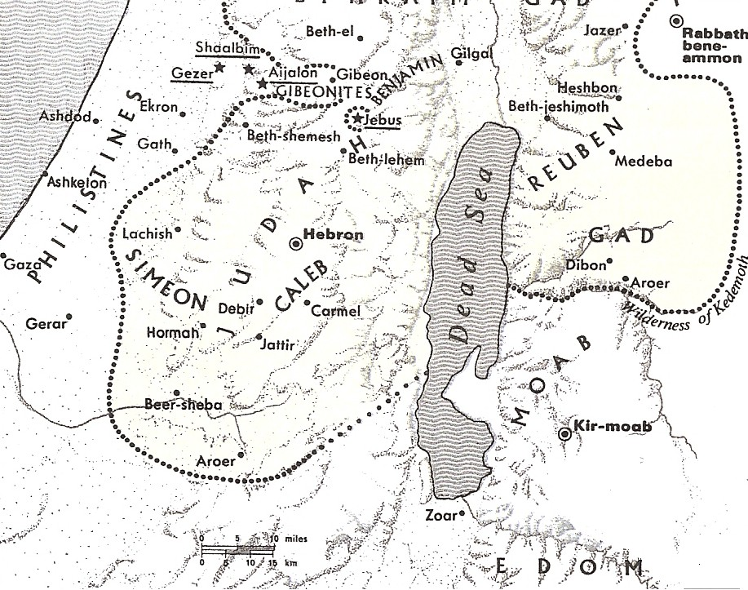

Slide 18
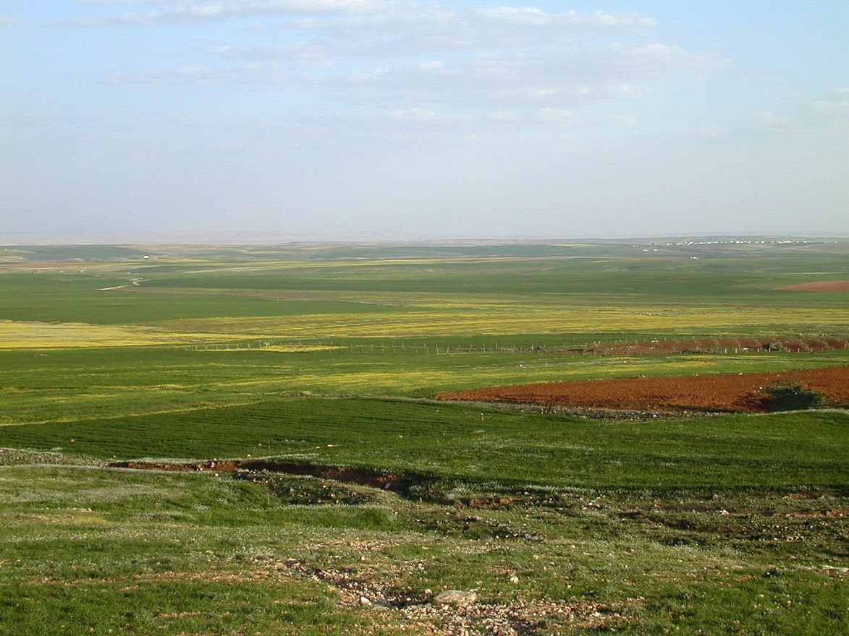
This photo is from the collection "Pictorial Library of Bible Lands, volumes 1-10," © 2006 by Todd Bolen, BiblePlaces.com
1.2b: Now they entered the land of Moab and remained there.

Slide 19
Deuteronomy 23.3-6: No Ammonite or Moabite shall enter the assembly of the LORD; none of their descendants, even to the tenth generation, shall ever enter the assembly of the LORD, because they did not meet you with food and water on the way when you came out of Egypt… You shall never seek their peace or their prosperity all your days.

Slide 20
Ruth 1.3: Then Elimelech, Naomi's husband, died; and she was left with her two sons.

Slide 21
Ruth 1.4: They took for themselves Moabite women as wives; the name of the one was Orpah and the name of the other Ruth. And they lived there about ten years.

Slide 22
Deuteronomy 7:1-2: When the LORD your God brings you into the land where you are entering to possess it, and clears away many nations before you, the Hittites and the Girgashites and the Amorites and the Canaanites and the Perizzites and the Hivites and the Jebusites, seven nations greater and stronger than you, and when the LORD your God delivers them before you and you defeat them, then you shall utterly destroy them.

Slide 23
Deuteronomy 7:2-4: You shall make no covenant with them and show no favor to them. Furthermore, you shall not intermarry with them; you shall not give your daughters to their sons, nor shall you take their daughters for your sons. For they will turn your sons away from following Me to serve other gods; then the anger of the LORD will be kindled against you and He will quickly destroy you.

Slide 24
1 Kings 11.1-2: Now King Solomon loved many foreign women along with the daughter of Pharaoh: Moabite, Ammonite, Edomite, Sidonian, and Hittite women, from the nations concerning which the LORD had said to the sons of Israel, “You shall not associate with them, nor shall they associate with you, for they will surely turn your heart away after their gods.”

Slide 25
Ruth 1.5: Then both Mahlon and Chilion also died, and the woman was bereft of her two children and her husband.

Slide 26
Deuteronomy 7.12-13: Then it shall come about, because you listen to these judgments and keep and do them, that the LORD your God will keep with you His covenant and His lovingkindness which He swore to your forefathers. He will love you and bless you and multiply you; He will also bless the fruit of your womb and the fruit of your ground…

Slide 27
Deuteronomy 7.13-14: … your grain and your new wine and your oil, the increase of your herd and the young of your flock, in the land which He swore to your forefathers to give you. You shall be blessed above all peoples; there will be no male or female barren among you or among your cattle.

Slide 28
Understand historical and literary context.
Analyze the tension, the reactions of the characters to resolve that tension, and the results of these reactions.
Consider what the author includes/excludes, what he emphasizes/minimizes.

Slide 29
† Time when judges ruled = cycle of disobedience, discipline from God, repentance, blessing from God.
† Tension 1: lack of food due to famine brought by God because of disobedience. Instead of seeking a covenant answer, Elimelech responded with human wisdom by going to Moab, forbidden by God. He led his family astray, and then God killed him.
† Tension 2: lack of children. Instead of seeking a covenant answer, Elimelech’s sons responded with human wisdom by marrying Moabite women, which was forbidden by God. They lived ten years with infertility and then God killed them too.

Slide 30
1. Relate to God, reflect his image, and show God devotion, dependence, and submissive obedience.
2. Expect discipline from God if you are wayward.
3. Repent of sin, choose to start obeying God and trusting in God’s provision.

